Slide 1
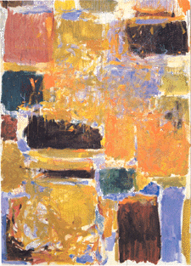
Digital Integrated Circuits A Design Perspective
Jan M. Rabaey
Anantha Chandrakasan
Borivoje Nikolic
Arithmetic Circuits
January, 2003

Slide 2
A Generic Digital Processor

Slide 3
Building Blocks for Digital Architectures
Arithmetic unit
-
Bit-sliced datapath
(adder, multiplier, shifter, comparator, etc.)
Memory
- RAM, ROM, Buffers, Shift registers
Control
- Finite state machine (PLA, random logic.)
- Counters
Interconnect
- Switches
- Arbiters
- Bus

Slide 4
An Intel Microprocessor
Itanium has 6 integer execution units like this

Slide 5
Bit-Sliced Design

Slide 6
Bit-Sliced Datapath

Slide 7
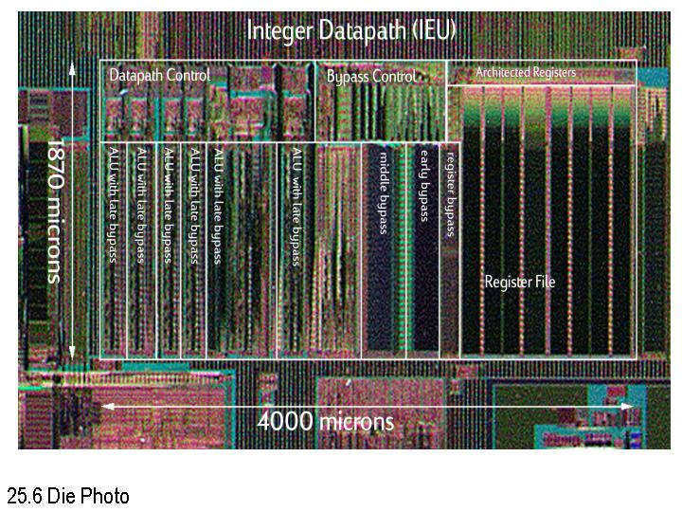
Itanium Integer Datapath
Fetzer, Orton, ISSCC’02

Slide 8
Adders

Slide 9
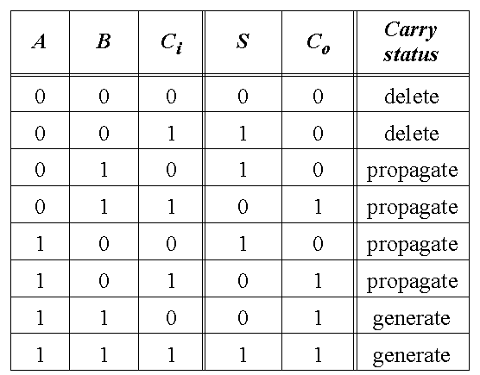
Full-Adder

Slide 10
The Binary Adder

Slide 11
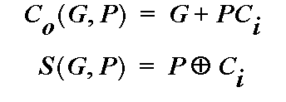
Express Sum and Carry as a function of P, G, D
Define 3 new variable which ONLY depend on A, B
Generate (G) = AB
Propagate (P) = A
⊕
B
Delete =
A
B
Can also derive expressions for
S
and
C
o
based on
D and P
Note that we will be sometimes using an alternate definition for
Propagate (P) = A
+
B

Slide 12
The Ripple-Carry Adder
Worst case delay linear with the number of bits
t_{d} = O(N)
t_{adder} = (N-1)t_{carry} + t_{sum}
Goal: Make the fastest possible carry path circuit

Slide 13
Complimentary Static CMOS Full Adder
28 Transistors

Slide 14
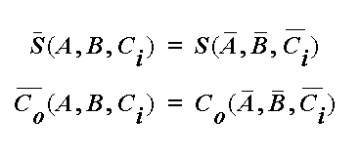
Inversion Property

Slide 15
Minimize Critical Path by Reducing Inverting Stages
Exploit Inversion Property

Slide 16
A Better Structure: The Mirror Adder

Slide 17
Mirror Adder
Stick Diagram

Slide 18
The Mirror Adder
The NMOS and PMOS chains are completely symmetrical. A maximum of two series transistors can be observed in the carry-generation circuitry.
When laying out the cell, the most critical issue is the minimization of the capacitance at node C_{o}. The reduction of the diffusion capacitances is particularly important.
The capacitance at node C_{o} is composed of four diffusion capacitances, two internal gate capacitances, and six gate capacitances in the connecting adder cell .
The transistors connected to C_{i} are placed closest to the output.
Only the transistors in the carry stage have to be optimized for optimal speed. All transistors in the sum stage can be minimal size.

Slide 19
Transmission Gate Full Adder

Slide 20
Manchester Carry Chain

Slide 21
Manchester Carry Chain

Slide 22
Manchester Carry Chain
Stick Diagram

Slide 23
Carry-Bypass Adder
Also called Carry-Skip

Slide 24
Carry-Bypass Adder (cont.)
t_{adder} = t_{setup} + M_{tcarry} + (N/M-1)t_{bypass} + (M-1)t_{carry} + t_{sum}

Slide 25
Carry Ripple versus Carry Bypass

Slide 26
Carry-Select Adder

Slide 27
Carry Select Adder: Critical Path

Slide 28
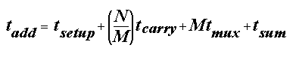
Linear Carry Select

Slide 29
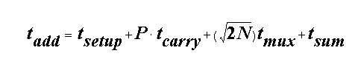
Square Root Carry Select

Slide 30
Adder Delays - Comparison

Slide 31
LookAhead - Basic Idea

Slide 32
Look-Ahead: Topology
Expanding Lookahead equations:
All the way:

Slide 33
Logarithmic Look-Ahead Adder

Slide 34
Carry Lookahead Trees
Can continue building the tree hierarchically.

Slide 35
Tree Adders
16-bit radix-2 Kogge-Stone tree

Slide 36
Tree Adders
16-bit radix-4 Kogge-Stone Tree

Slide 37
Sparse Trees
16-bit radix-2 sparse tree with sparseness of 2

Slide 38
Tree Adders
Brent-Kung Tree

Slide 39
Example: Domino Adder
Propagate
Generate

Slide 40
Example: Domino Adder
Propagate
Generate

Slide 41
Example: Domino Sum

Slide 42
Multipliers

Slide 43
The Binary Multiplication

Slide 44
The Binary Multiplication

Slide 45
The Array Multiplier

Slide 46
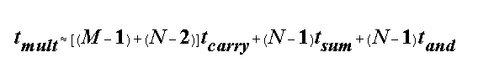
The MxN Array Multiplier — Critical Path
Critical Path 1 & 2

Slide 47
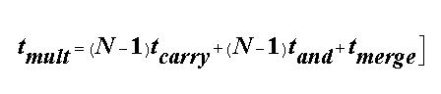
Carry-Save Multiplier

Slide 48
Multiplier Floorplan

Slide 49
Wallace-Tree Multiplier

Slide 50
Wallace-Tree Multiplier

Slide 51
Wallace-Tree Multiplier

Slide 52
Multipliers —Summary

Slide 53
Shifters

Slide 54
The Binary Shifter

Slide 55
The Barrel Shifter
Area Dominated by Wiring

Slide 56
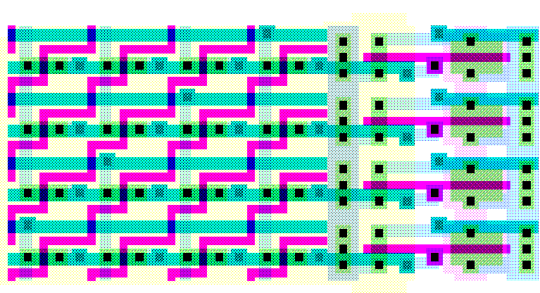
4x4 barrel shifter
Width_{barrel} ~ 2 p_{m} M

Slide 57
Logarithmic Shifter

Slide 58
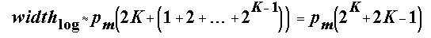
0-7 bit Logarithmic Shifter
A
3
Out3
A
2
Out2
A
1
Out1
A
0
Out0

